Slide 1
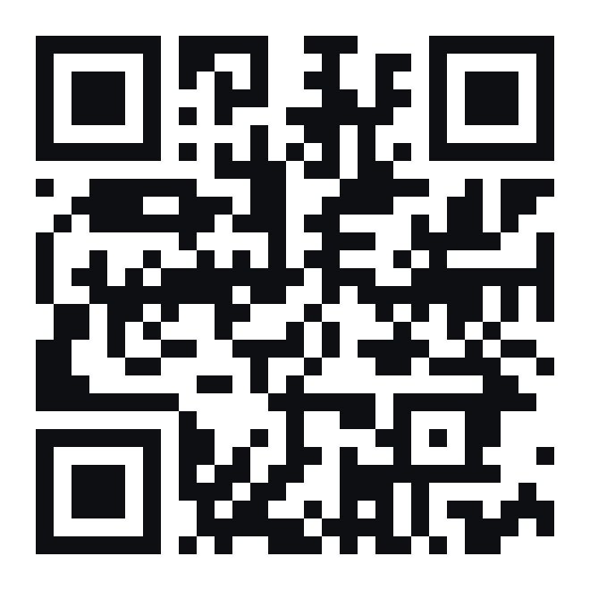
Johnson[X]Corp
[ BUILT BY A STUDENT, FOR STUDENTS ]
Four free apps that
make uni easier.
Plan your term, study your notes, read faster and learn a language. All in your browser, all free.
Scan to open
thepastor.github.io
Presented by Anndy · JohnsonXCorp
Notes:
Hi everyone, I'm Anndy. Over the last few weeks I've built four free web apps to fix the things that annoy me most about uni. If you want to follow along, scan the QR code now — it opens on your phone, no download.

Slide 2
[ SOUND FAMILIAR? ]
Uni has a lot of moving parts.
5
40+
300
1 night
course outlines, each with its own dates buried in a PDF
deadlines a term, spread across five different course sites
pages of reading before the midterm, and a week to do it
the usual amount of studying before the exam
Rough numbers for a typical full course load. Hands up if any of these is you.
thepastor.github.io
Notes:
Quick show of hands — who has lost track of a due date this term? Who has a pile of readings they haven't touched? These are rough numbers for a full course load, but you get the idea. Each app I'm about to show you tackles one of these.

Slide 3
[ THE TOOLKIT ]
One link. Four apps.
PLAN
STUDY
READ
LEARN
Syllabus Desk
UNI Made EZ
Read Fast
Vamos
Every deadline from your course outlines, on one calendar.
Your lecture files, turned into flashcards and quizzes.
Read your textbooks one word at a time, at your speed.
Learn Spanish, French or Japanese in small daily steps.
Free · No download · Works on your phone · No account needed to start
thepastor.github.io
Notes:
Everything lives at one address: thepastor.github.io. From there you can open any of the four. They're all free, they all run in your browser, and none of them makes you sign up before you can try it.

Slide 4
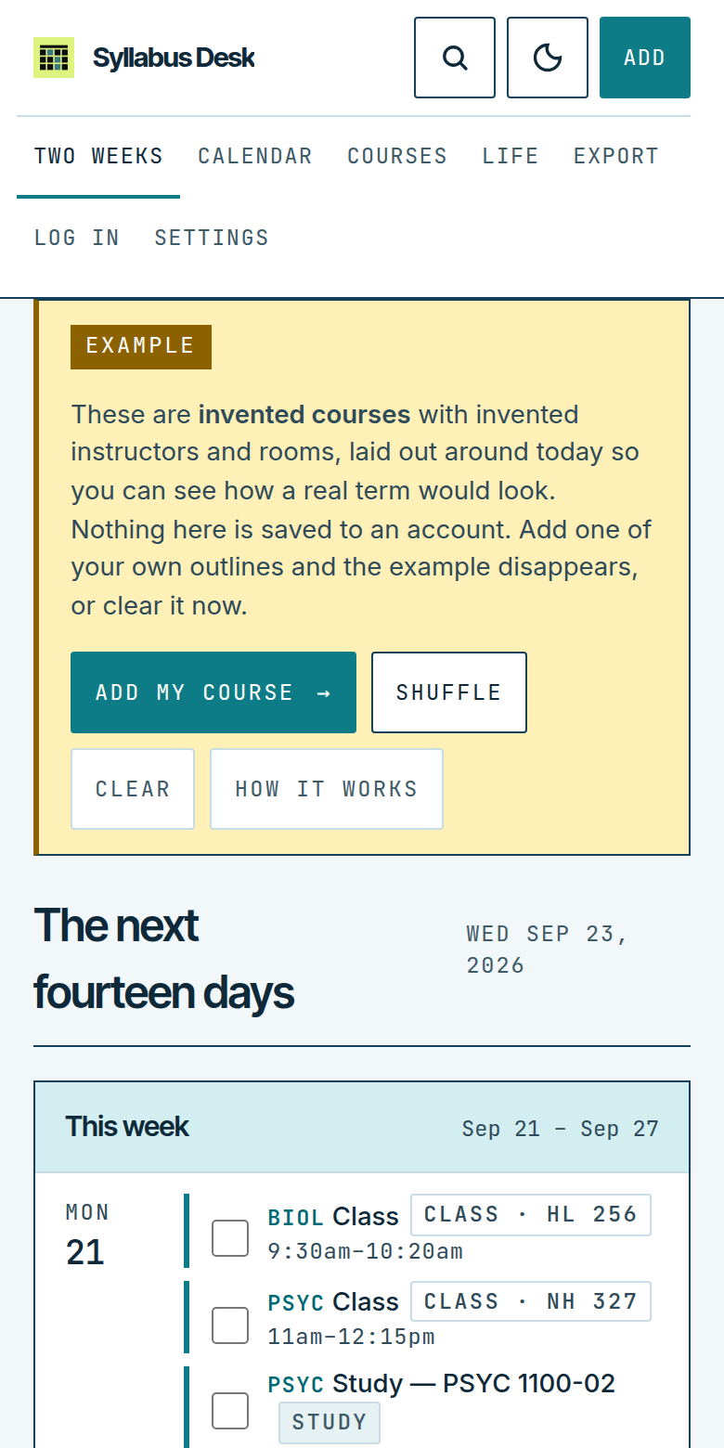
[ 01 · PLAN ]
Syllabus Desk
Turn your course outlines into one calendar with every deadline in the term.
Paste an outline, or drop in the PDF or Word file
It pulls out exams, quizzes, reports and due dates
You check every date in a table before anything is saved
Export to Google or Apple Calendar so reminders follow you
Add work shifts and the gym so your week is real
Open it: thepastor.github.io/syllabus-desk
Notes:
Syllabus Desk is the one I use most. You add each course outline once — paste it or drop in the PDF — and it finds every dated item. Nothing is guessed: if the outline doesn't give a date, it's flagged. Then you export the whole term to your phone's calendar. There's an example term you can load to see how it looks.

Slide 5
[ HOW TO USE IT ]
Your whole term in about 10 minutes
1
2
3
4
Add a course
Check the dates
Do every course
Export
Tap Add course and paste the outline, or drop in the PDF.
Every date lands in an editable table first. Fix anything that looks off.
Four or five outlines and your whole term is on one page.
Download the calendar file and import it into Google or Apple Calendar.
Tip: import into a separate calendar, so if something is wrong you delete one calendar instead of 40 events.
thepastor.github.io
Notes:
Here's the whole process. Add a course, check the dates, repeat, export. The tip at the bottom comes straight from the app's own help: put it in its own calendar so it's easy to undo.

Slide 6
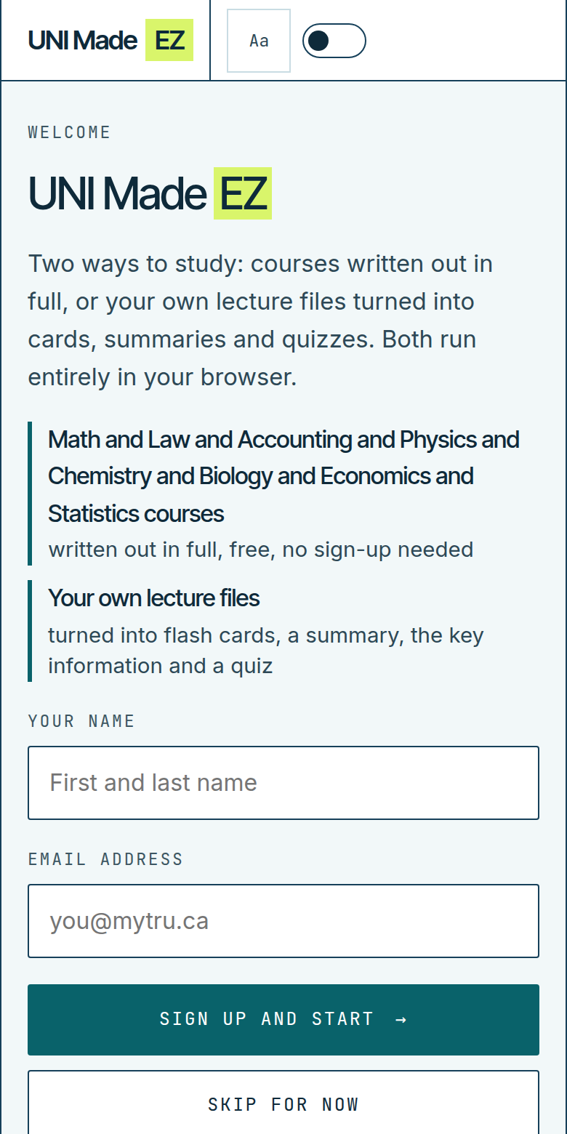
[ 02 · STUDY ]
UNI Made EZ
Two ways to study: full courses written out, or your own files turned into study material.
Drop in a PDF, Word file or text: get flashcards, a summary, key information and a quiz
Quizzes mix multiple choice, true/false and fill-in-the-blank
Full courses written out in math, law, accounting, sciences, economics and stats
Works offline once it has loaded
Sign-up is optional; the whole app works without it
Open it: thepastor.github.io/uni-made-ez
Notes:
UNI Made EZ is for the week before a midterm. Give it your lecture slides or notes and it builds flashcards, a summary, the key points and a practice quiz. It all happens in your browser — your files aren't uploaded anywhere. There's also a library of full courses written out if you want to review a subject from scratch.

Slide 7
[ HOW TO USE IT ]
From lecture slides to a practice quiz
1
Open UNI Made EZ
Tap Skip for now, or sign up if you like. It works the same either way.
Why it works
Testing yourself beats re-reading. It's one of the best-supported findings in learning research: retrieval practice, also called the testing effect.
2
Add your file
Drop in lecture slides as PDF, Word or text.
3
Pick how to study
Flashcards, Summary, Key information or Quiz, each on its own page.
4
Test yourself
Take the quiz, see what you missed, and go again.
thepastor.github.io
Notes:
The science bit: quizzing yourself — retrieval practice — works better than rereading or highlighting. UNI Made EZ just makes that the easy option. Four steps: open it, add your file, pick a mode, test yourself.

Slide 8
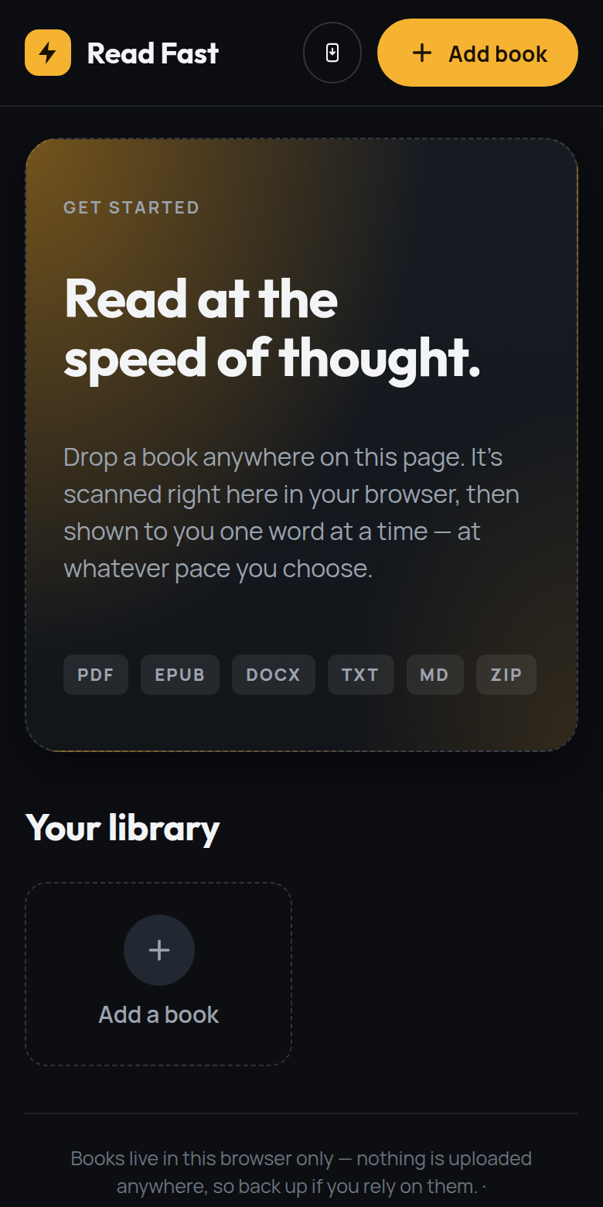
[ 03 · READ ]
Read Fast
Read books and readings one word at a time, in the middle of the screen, at the pace you choose.
Opens PDF, EPUB, Word, text, Markdown and ZIP files
Set your words per minute and speed up as you get comfortable
Pause any time and pick up exactly where you left off
Tracks words read, reading time and your daily streak
Your books stay in your browser. Nothing is uploaded.
Open it: thepastor.github.io/read-fast
Notes:
Read Fast uses a technique called RSVP — rapid serial visual presentation. Instead of your eyes moving across lines, the words come to you in one spot. Start slow, around 200 words a minute, and bump it up. It's great for getting through long readings on the bus.

Slide 9
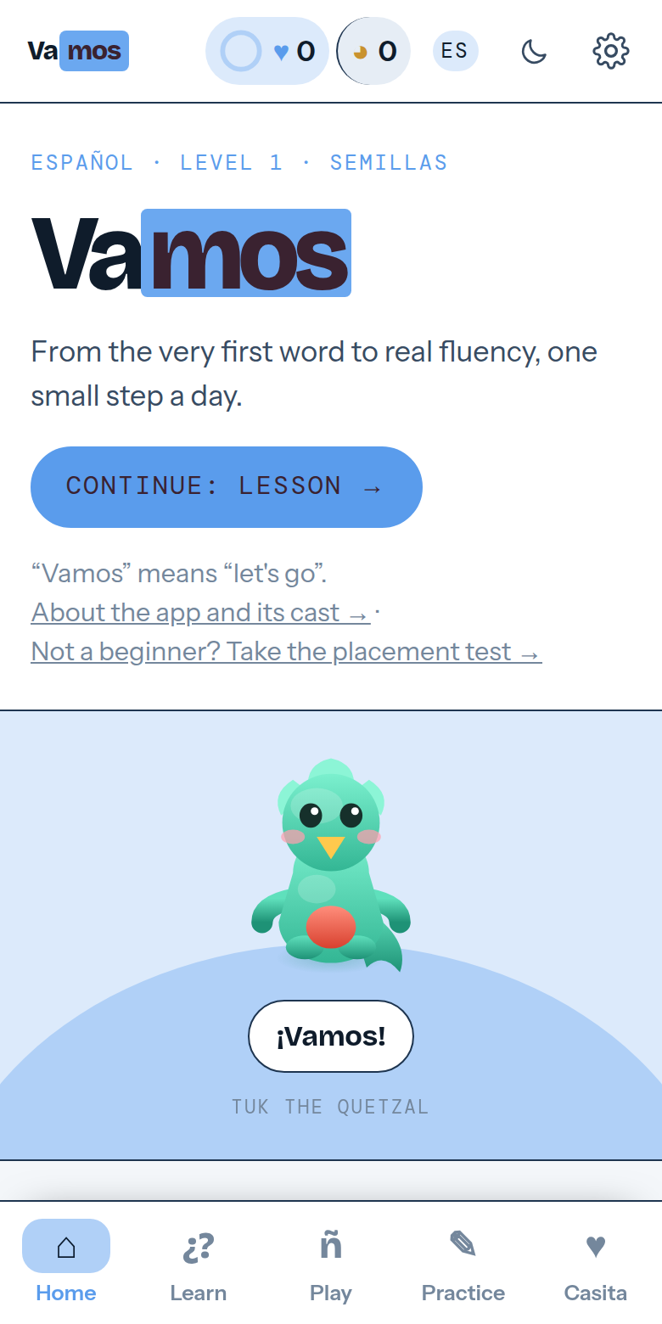
[ 04 · LEARN ]
Vamos
A full language course with a lesson path, daily streaks and games that make practice feel like play.
Spanish, French and Japanese
Speaking practice, dictation, sentence building and spaced review
Games like Mercado, Lotería and a daily crossword
Earn XP to grow a companion character as you improve
Everything unlocked from day one
Open it: thepastor.github.io/vamos
Notes:
Vamos is for anyone with a language requirement, or anyone who just wants to learn one. It's built like the big language apps — lessons, streaks, games — but free and with no ads. You earn XP and your character grows as you do.

Slide 10
[ WHY USE THEM ]
Built around how students actually work
$0
0 MB
10 sec
Free
No download
On your phone
No subscription, no trial, no card.
Opens in any browser on any device.
Add it to your home screen like an app.
Offline
No ads
Always new
Study anywhere
No distractions
Updated all the time
UNI Made EZ, Read Fast and Vamos keep working without Wi-Fi.
Nothing popping up while you study.
New features land without an update to install.
thepastor.github.io
Notes:
To sum up the benefits: free, nothing to download, works on your phone, most of it works offline, and there are no ads.

Slide 11
[ PRIVACY ]
Your stuff stays yours
App | Stays on your device | What leaves your device
Read Fast | Your books, your place in them, your stats | Nothing
UNI Made EZ | Your files, cards, summaries and quizzes | Only your name and email, if you choose to sign up
Syllabus Desk | The file, your schedule, your edits | The outline text is sent to Claude (AI) to find the dates. Optional accounts store your term in Canada.
Vamos | Everything while you try it out | Your progress syncs to an account once you pass 100 XP, so it follows you between devices
No ads, no tracking for advertising, and nothing sold. Each app has a legal & privacy page with the full details. These are independent projects by JohnsonXCorp, not a TRU service.
thepastor.github.io
Notes:
I care about this one, so here's exactly what happens to your data. Read Fast and UNI Made EZ do everything in your browser. Syllabus Desk sends the outline text to Claude, an AI model, to read the dates — that's the only thing that leaves your device. Vamos saves progress to an account once you've earned 100 XP, so you don't lose it. And to be clear, these are my own projects, not official TRU tools.

Slide 12
[ PUT IT ON YOUR PHONE ]
Make it an app in 10 seconds
iPhone · Safari
Android · Chrome
1
Open the app in Safari
1
Open the app in Chrome
2
Tap the Share button
2
Tap the ⋮ menu
3
Tap Add to Home Screen, then Add
3
Tap Install app or Add to Home screen
thepastor.github.io
Notes:
Do this once and the app sits on your home screen, opens full-screen, and most of them work offline. On iPhone it's Share, Add to Home Screen. On Android it's the three-dot menu, Install app.

Slide 13

[ TRY IT NOW ]
Two-minute challenge
1
Scan the code
Opens the JohnsonXCorp homepage on your phone.
2
Open Syllabus Desk
Tap Load an example term to see a full semester.
3
Add one real course
Paste this class's outline and watch the dates appear.
Scan me
thepastor.github.io
thepastor.github.io
Notes:
Let's try it right now. Scan the code, open Syllabus Desk, and load the example term. If you've got this class's outline handy, paste it in and see the dates appear. I'll give you two minutes, then I'll show it on the big screen.

Slide 14
Johnson[X]Corp
Try one this week.
Tell me what to build next.
Found a bug, or want a feature for your program? I read every message.
Questions?
WEBSITE
thepastor.github.io
EMAIL
johnsonxcorp@outlook.com
Notes:
That's it. All four apps are free at thepastor.github.io. Try one this week, and if there's something you wish it did, email me — I build new features based on what students ask for. Happy to take questions.

